Slide 1
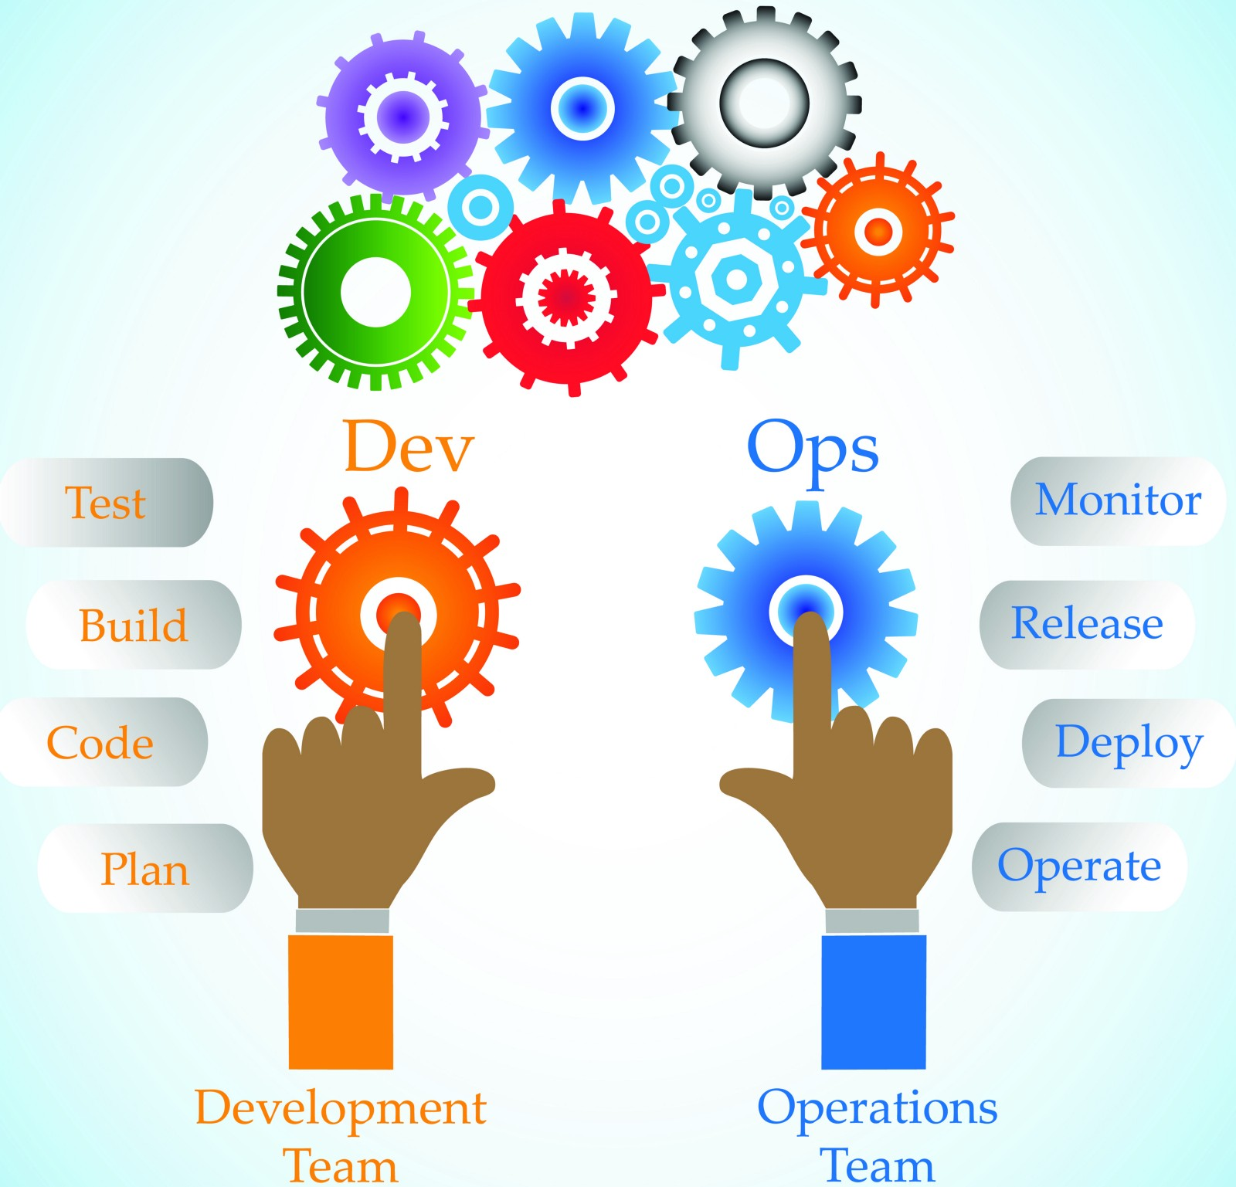





DevOps
DevOps is a software development approach which involves continuous development, continuous testing, continuous integration, continuous deployment and continuous monitoring of the software throughout its development life cycle.

Slide 2
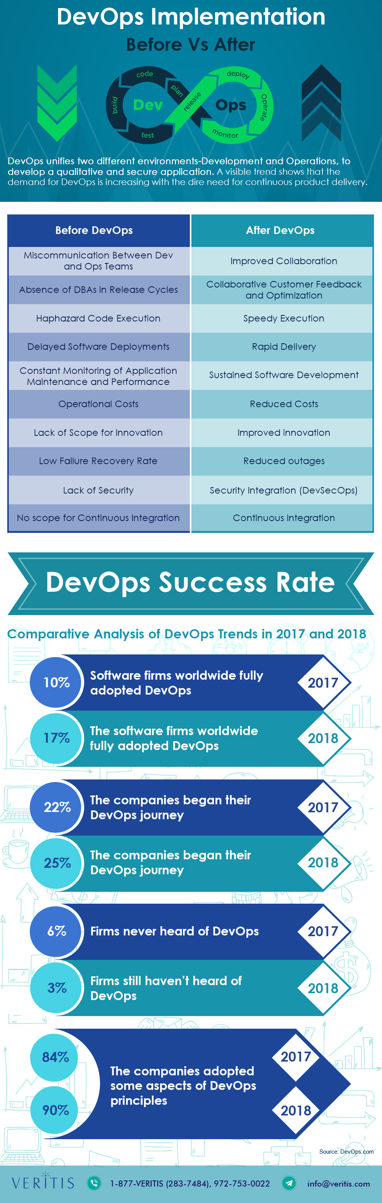
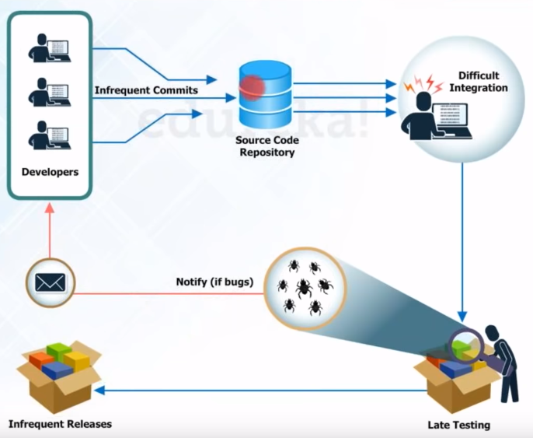
Before DevOps

Slide 3
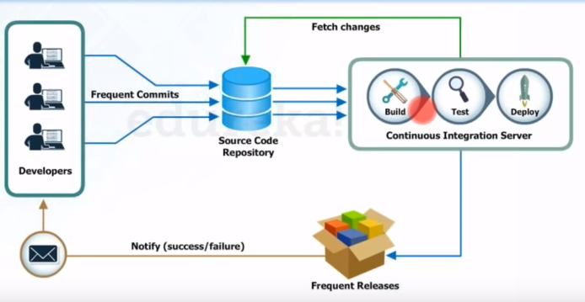
After DevOps

Slide 4
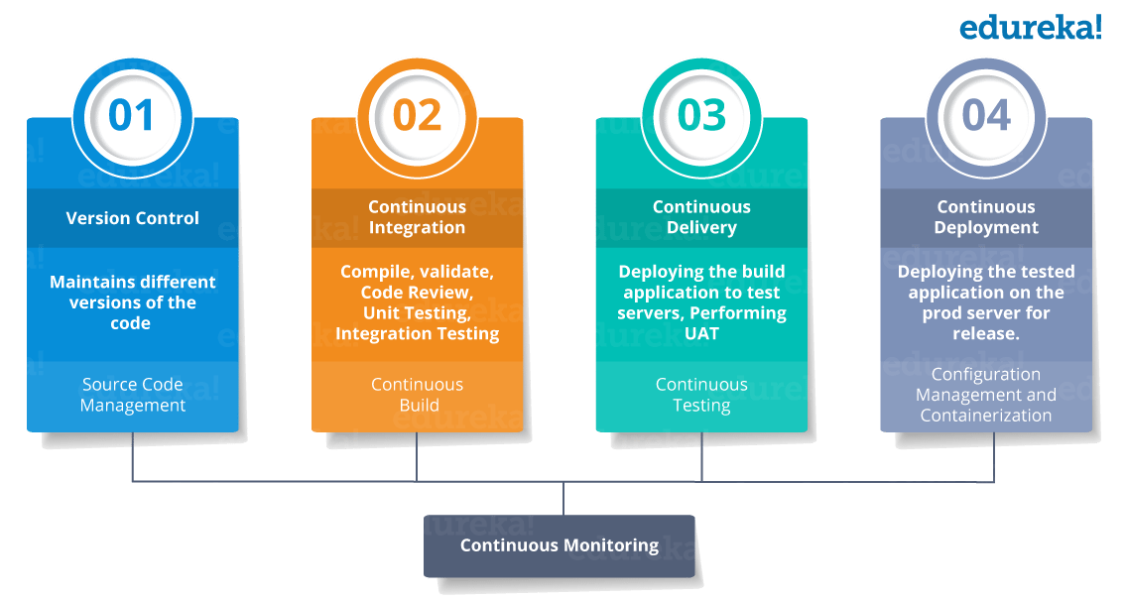
DevOps Stages

Slide 5
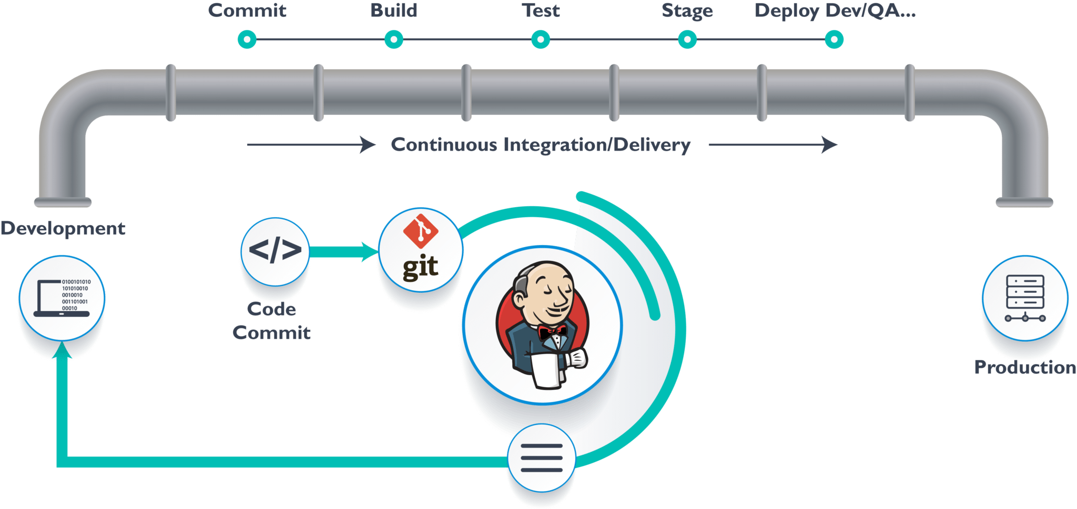
Jenkins Pipeline

Slide 6



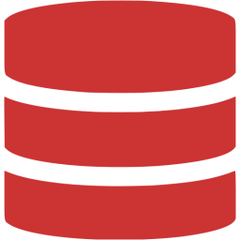
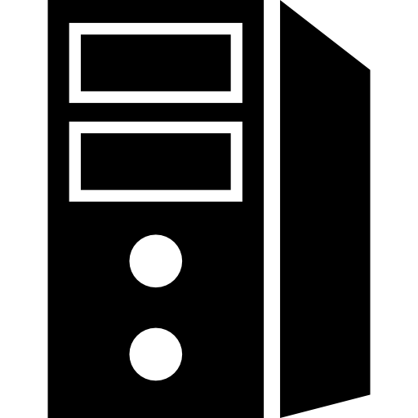
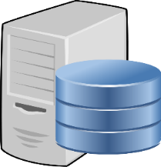


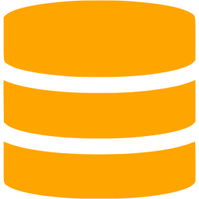


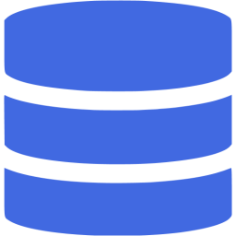
CI Workflow
DEVELOPMENT
CONTINUOUS INTEGRATION
BUILD
Trigger
SOURCE CONTROL
TEST
Feedback Mechanism

Slide 7
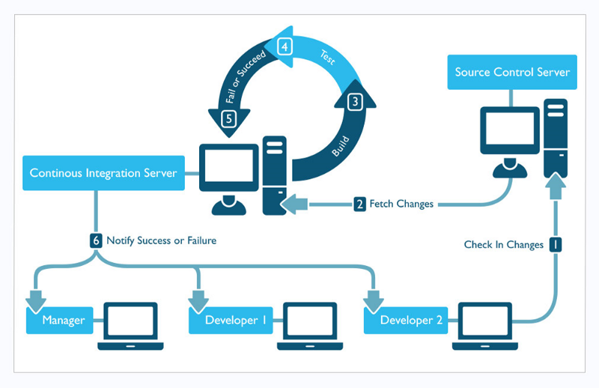
CI/CD TOOLS
CI TOOLS
Git
Bit bucket
Gradle
Jenkins
Sonar Qube
Nexus
Junit
Jacoco
CD TOOLS
Docker Hub
Ansible
Docker
Kubernetes

Slide 8
CI/CD Workflow
Developer
Developer
Git
Bit Bucket
Jenkins
Gradle
Sonar Qube
JUnit
JACOCO
Docker
K8S

Slide 9
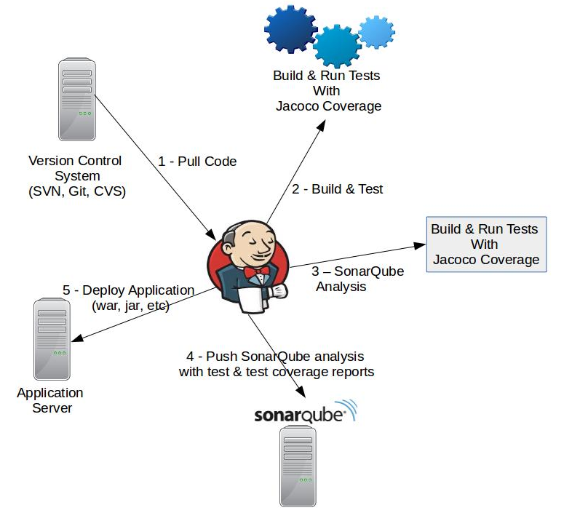
Sonar Qube
Increases productivity of software teams, and their ability to collaborate.
static analysis of code to detect bugs, code smells, and security vulnerabilities in developing phase
Can be integrated with Jenkins
JUnit
provides a publisher that consumes XML test reports generated during the builds and provides some graphical visualization of the historical test results
It will provide web UI for viewing test reports, tracking failures, and so on
JACOCO
We are using for measuring the code coverage
Code coverage testing is determined how much being code is being tested and It helps you to measure the efficiency of test implementation

Slide 10
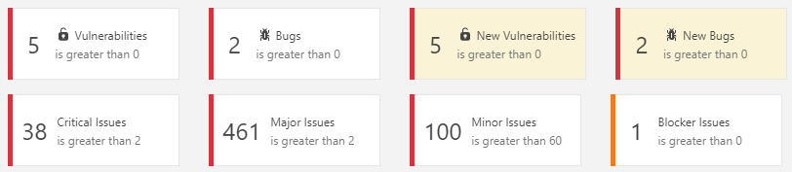
Benefits of Sonar Qube
DevOps team need to make sure software was built the right way.
Among them is supporting the development process, automating testing, ensuring quality, increasing productivity and ultimately enabling continuous deployment.
Good code quality is a necessary, although not sufficient, condition to achieve all these objectives.
Our solution provides a code quality toll-gate that can be added at any of the construction / testing / deployment steps.
This enables DevOps team to automatically enforce a set of quality criteria, which ensures that organizations deliver better software.

Slide 11
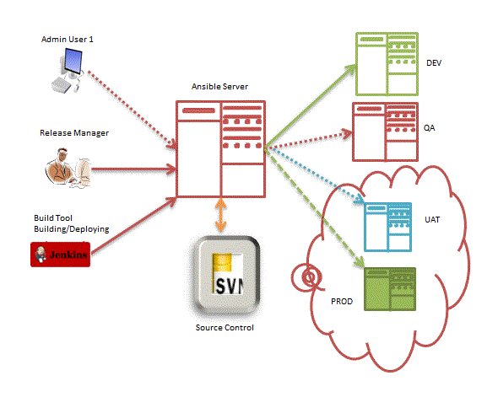
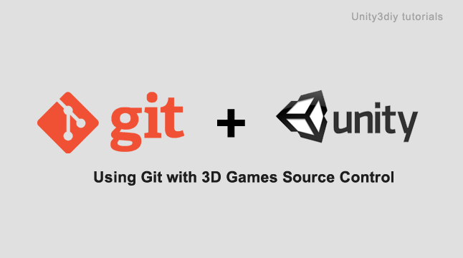
Ansible
simple and powerful
Agent-less
Secure – SSH based connection
Python / yaml based
Highly flexible and configuration management
of systems.
Large number of ready to use modules available
Human readable & Self documenting

Slide 12
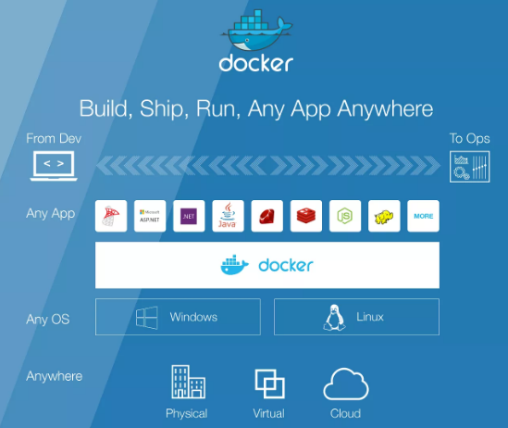
What is Docker
Docker is a container management service.
The keywords of Docker - develop, ship and run anywhere.
Build:
Docker allows you to compose your application
from microservices, without worrying about inconsistencies
between dev and prod environments
Ship:
Docker lets you design the entire cycle of application development,
testing and distribution, and manage it with a consistent user interface.
Run:
Docker offers you the ability to deploy scalable services,
securely and reliably, on a wide variety of platforms.

Slide 13
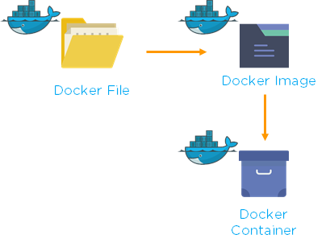
Docker Components
Docker File
is a text file that contains the necessary commands to assemble an image
Docker files automate the process of building these images
Docker Image
created by executing Docker file.
Layer structure
may contain any Software, Operating System or Service
What is Container
running instance of Docker image

Slide 14
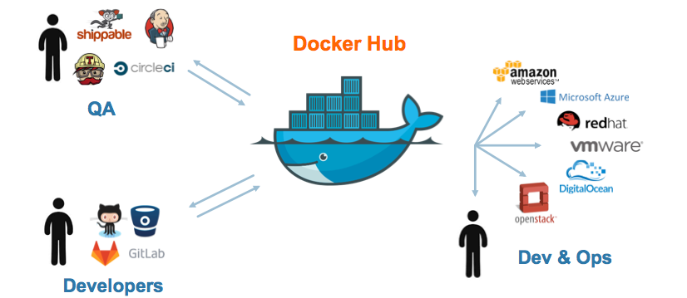
Docker Hub
Docker Hub is a registry service on the cloud
upload Docker images to Docker hub – push mechanism
Download Docker images from Docker hub – pull mechanism
creates a delta between the previous version and the latest one.

Slide 15
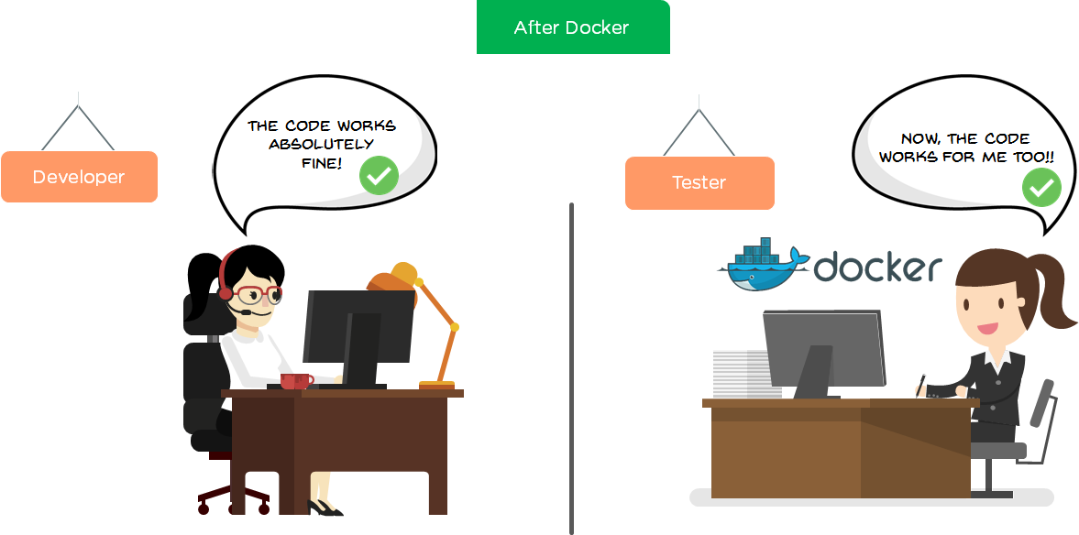
Lets understand with an example…
Imagine a developer is building an application and wants to send it to a tester. What happens next??
The code doesn’t work on the other system due to the difference in computer environments
So, what could be the solution to this? Is it Virtual machine or Docker?
Docker is the best solution for this.

Slide 16
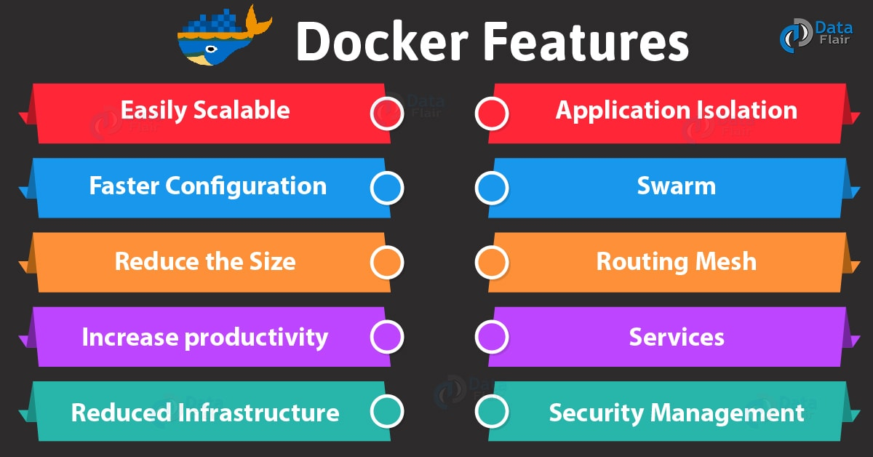
Docker Features
.

Slide 17
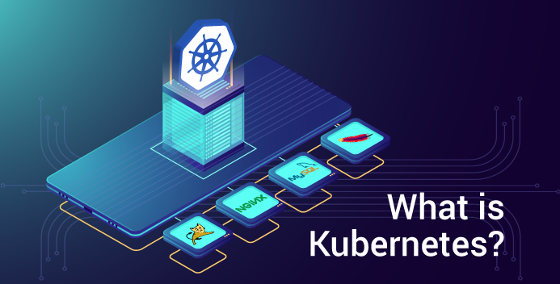
Kubernetes
Kubernetes is an open source container orchestration system that is powerful and runs Docker containers while ensuring that they are running continuously.
container deployment
scaling & descaling of containers
Container load balancing.
It suites for Microservices application architectures

Slide 18
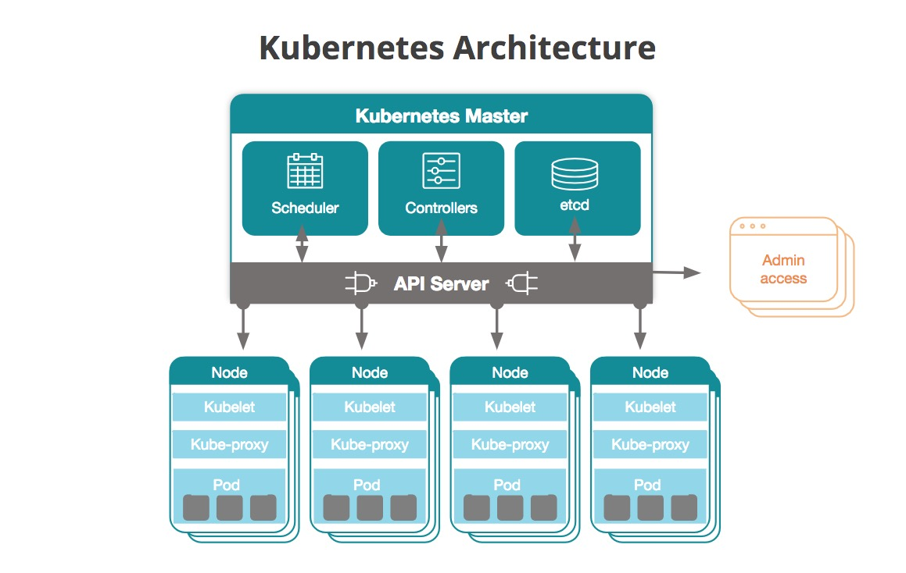
Kubernetes Architecture
Kubernetes Architecture has the following main components:
Master nodes
Worker/Slave nodes
Master Node
management of Kubernetes cluster.
Entry point for all administrative tasks.
Multiple master nodes - to check for fault tolerance
Worker Node
Manage networking between containers
communicate with the master node for tasks
assign resources to the scheduled containers

Slide 19
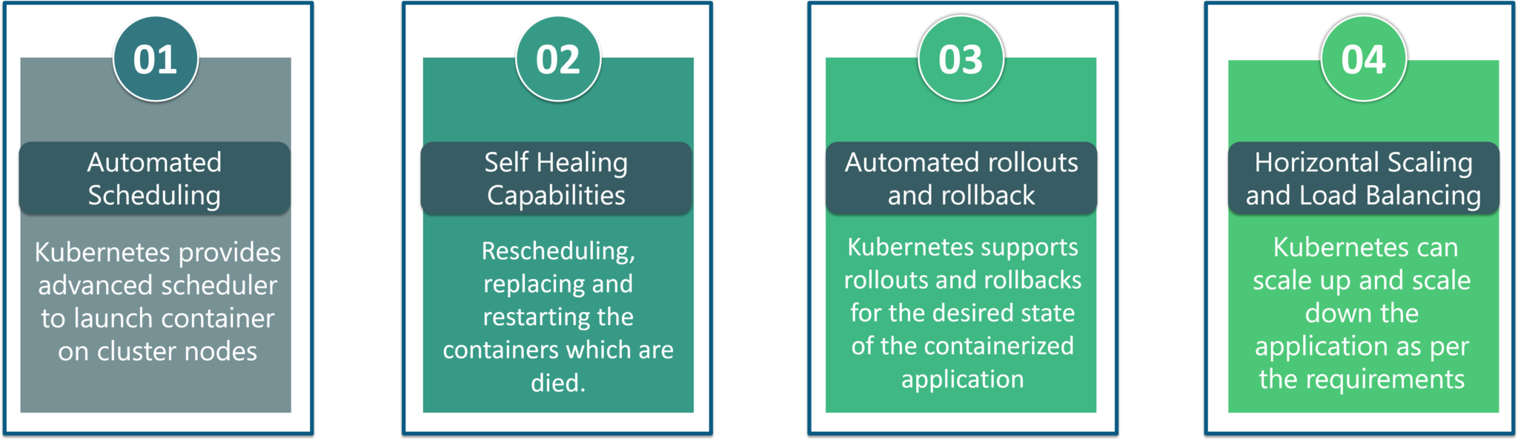
Kubernetes Features
Automated Scheduling: Kubernetes provides advanced scheduler to launch container on cluster nodes based on their resource requirements and other constraints, while not sacrificing availability.
Self Healing Capabilities: Kubernetes allows to replaces and reschedules containers when nodes die. It also kills containers that don’t respond to user-defined health check and doesn’t advertise them to clients until they are ready to serve.
Automated rollouts & rollback: Kubernetes rolls out changes to the application or its configuration while monitoring application health to ensure it doesn’t kill all your instances at the same time
Horizontal Scaling & Load Balancing: Kubernetes can scale up and scale down the application as per the requirements with a simple command, using a UI, or automatically based on CPU usage.

Slide 20
Conclusion
DevOps is an approach that improves the collaboration between Development and Operations teams. Enabling DevOps improves the speed of the delivery according to the business and customer needs
Especially automation in DevOps improves the productivity, reliability and allows standardizing the process, which in turn plays a major role in product delivery for organizations.
DevOps continues to be adapted by various organizations such as Facebook, Netflix, Walmart etc.
DevOps—the culture, the process frameworks and workflows, the emphasis on automation

